Slide 1
Training GAN on the new 11250 dataset
Zheng Lu

Slide 2
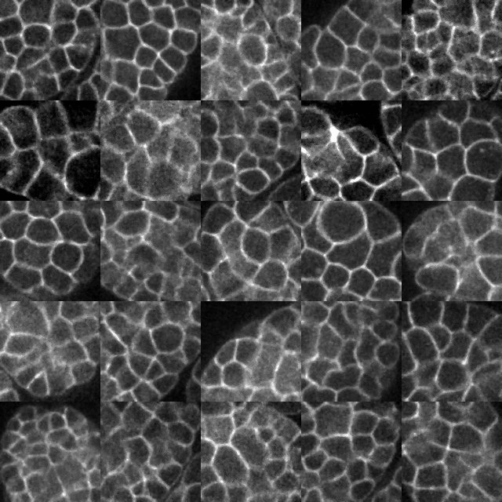
New dataset
In total of 45 embryos.
Cover time period from 61 to 110.
Cover slice from 9 to 13.
At each time period and each slice of a embryo, randomly select 1 image patch of size 128 x 128.
So each embryo has 5 * 50 = 250 random image patches.
In total we have 45 * 250 = 11250 image patches.

Slide 3
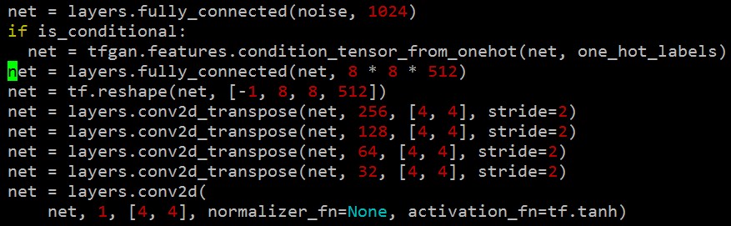
Training GAN on new dataset with different parameter settings
Input noise dimension:
0: 64
1: 128
Activation for G and D:
0: Relu for G, leaky relu for D
1: Leaky relu for both G and D
Learning rate:
0: 1e-4 for both
1: 3e-5 for both
Network size: symmetric G, D

Slide 4
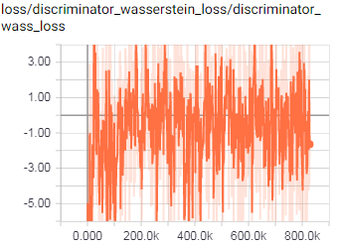
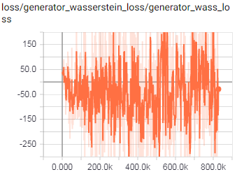
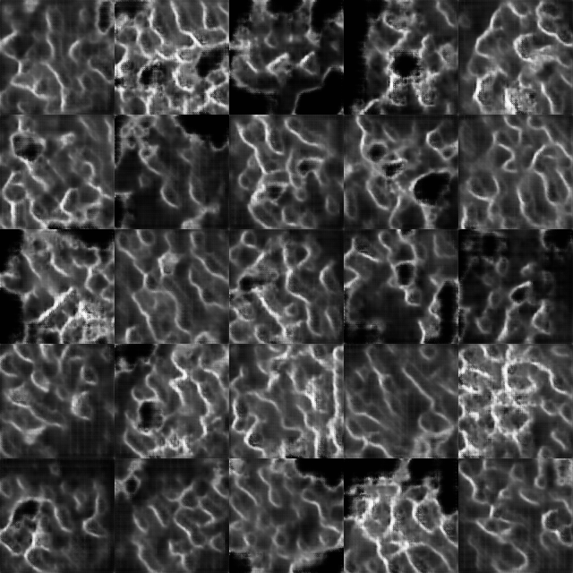
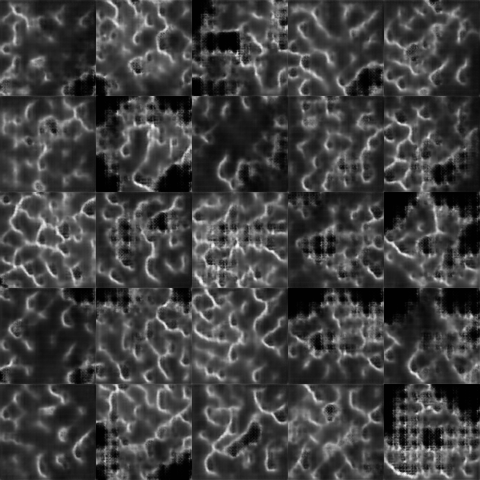
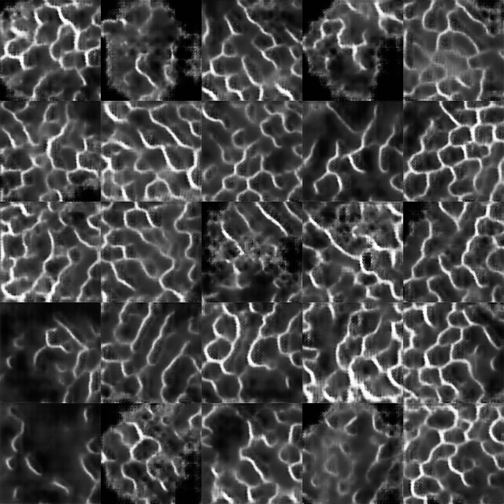
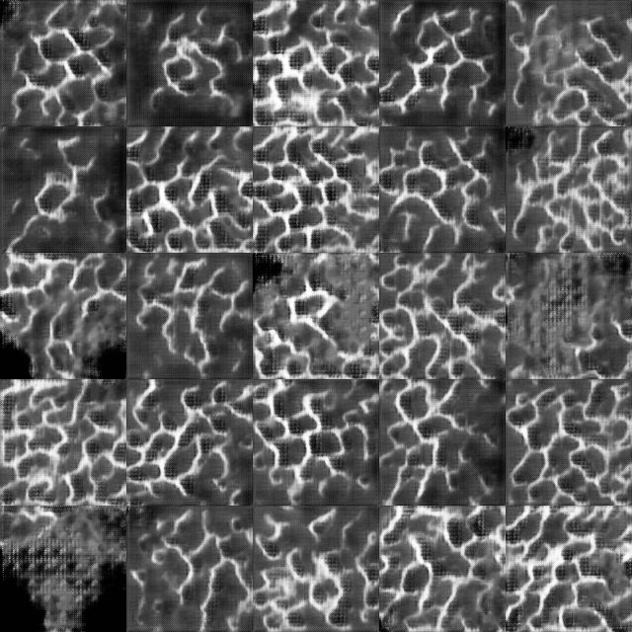
Setting 1 – [1, 0, 0]
D loss
G loss

Slide 5
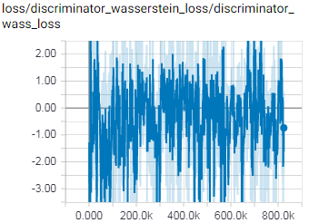
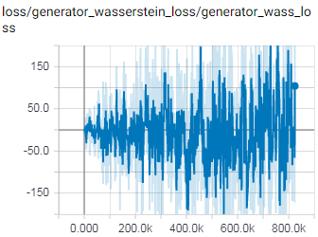
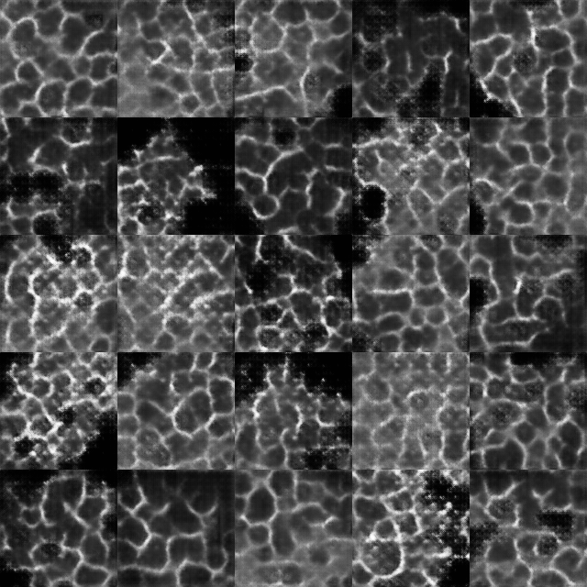
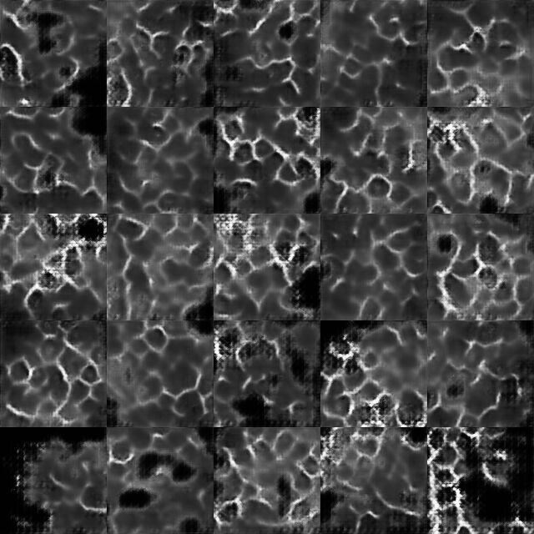
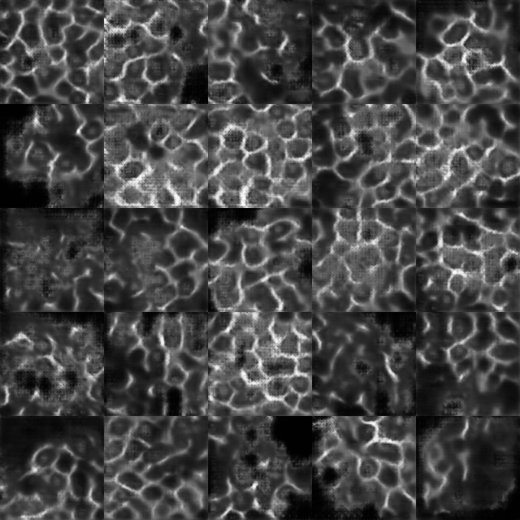
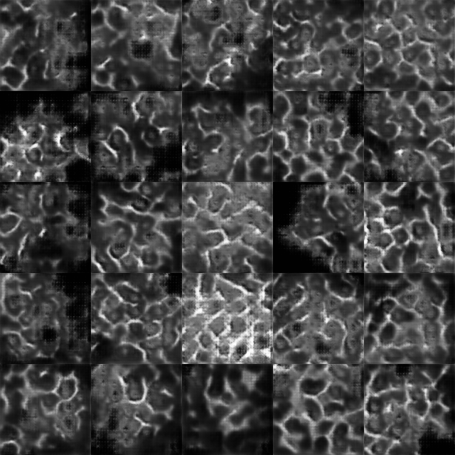
Setting 2 – [1, 0, 1]
D loss
G loss

Slide 6
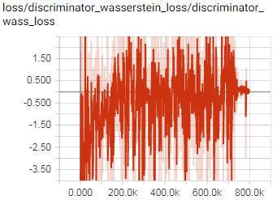
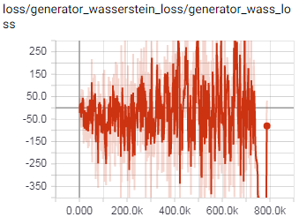
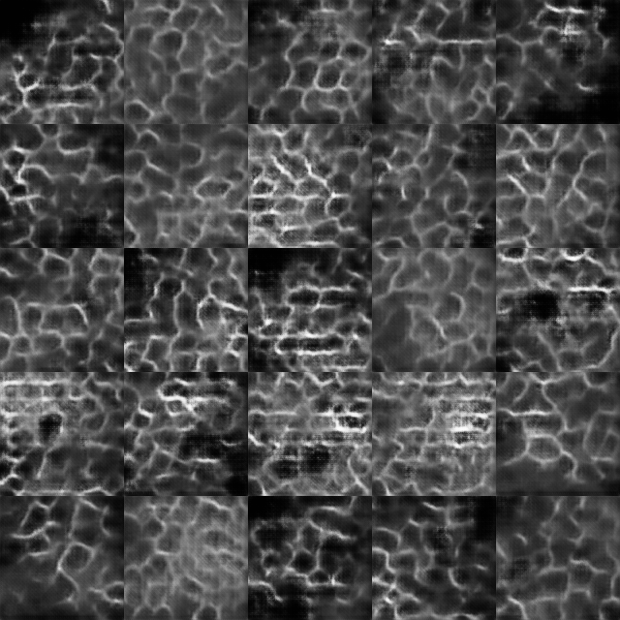
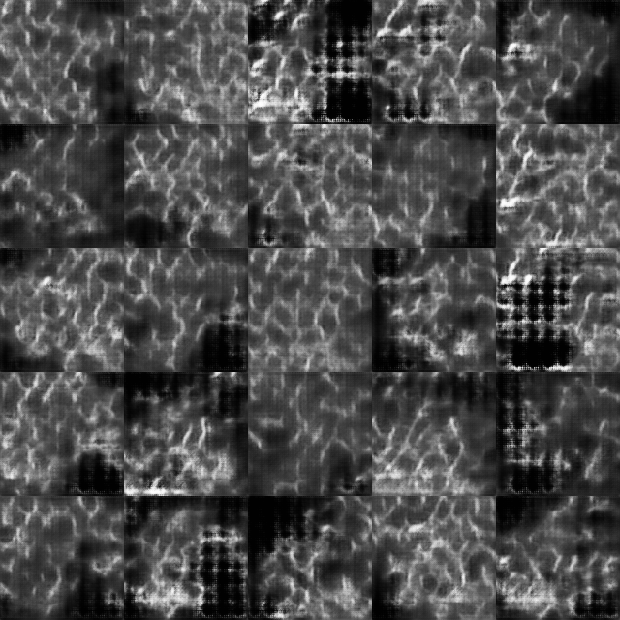
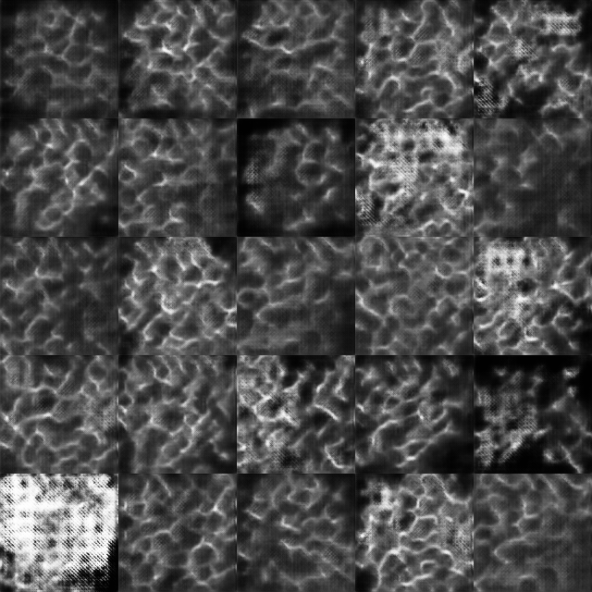
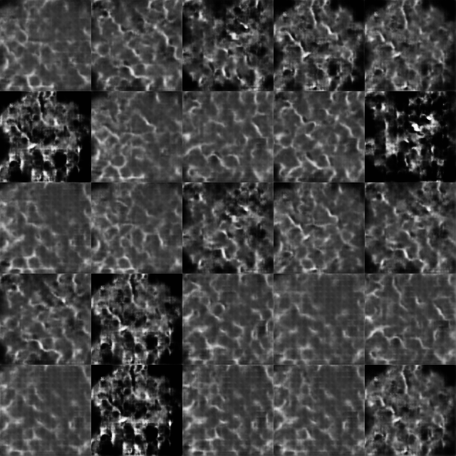
Setting 3 – [1, 1, 0]
D loss
G loss

Slide 7
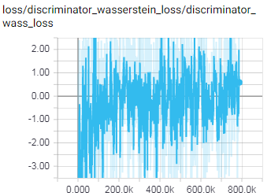
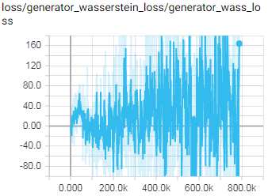
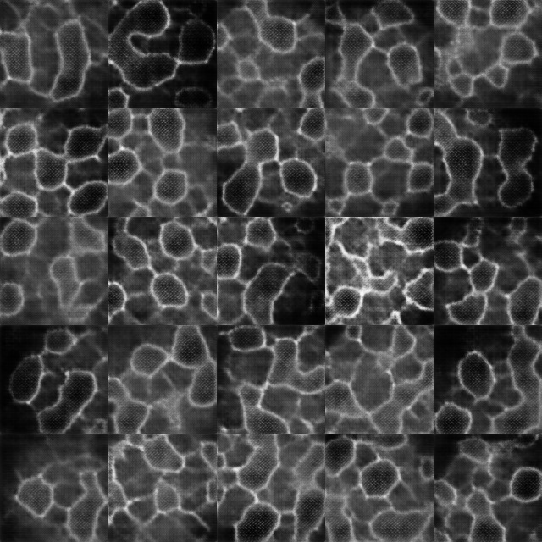
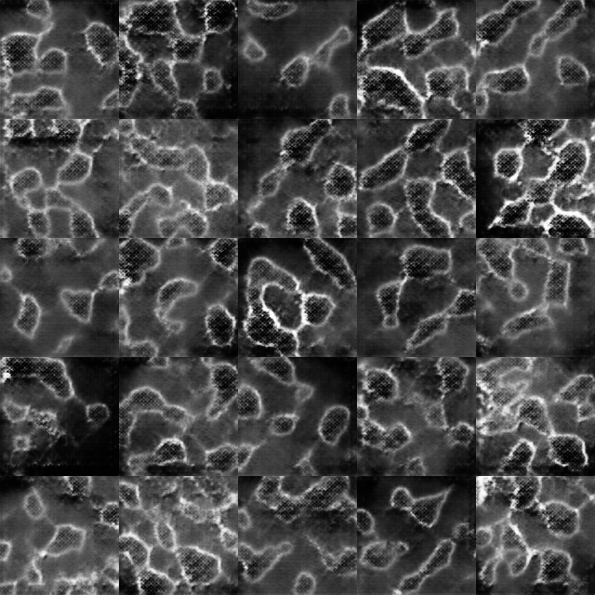
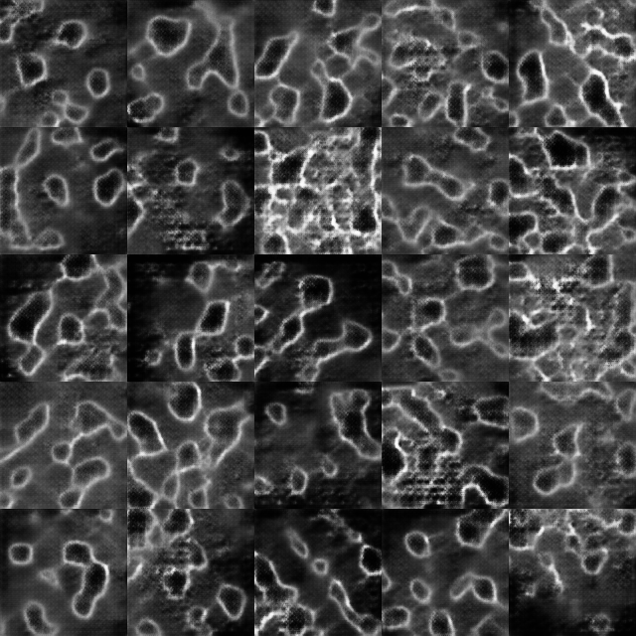
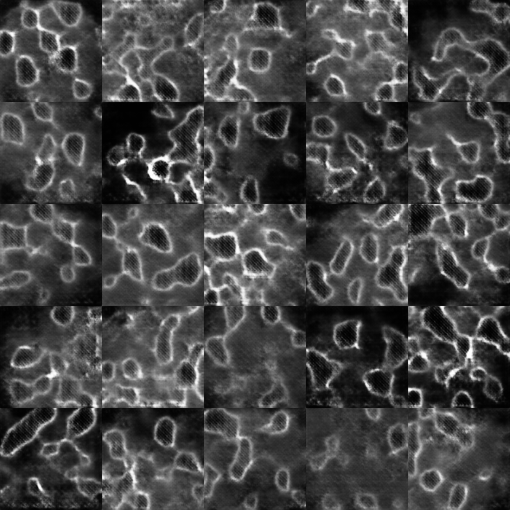
Setting 4 – [1, 1, 1]
D loss
G loss

Slide 8
Some thoughts after 4 experiments
It seems in all experiments, D converges to small losses, and G is not able to converge and beginning to diverge. D is training too well?
Use a small learning rate for D and a large learning rate for G

Slide 9
Training GAN on new dataset with different parameter settings
Input noise dimension:
0: 64
1: 128
Activation for G and D:
0: Relu for G, leaky relu for D
1: Leaky relu for both G and D
Learning rate:
0: 1e-4 for G, 3e-5 for D
1: 1e-4 for G, 1e-5 for D
Network size: symmetric G, D

Slide 10
Setting 5 – [1, 0, 1]
D loss
G loss

